Slide 1
Did Noah’s Flood Occur?
A Church Sign: “Taking the Bible seriously; although, not literally.”
Really…

Slide 2
Which Wisdom is Best?
1Co 3:19 For the wisdom of this world is foolishness with God.
2Co 4:4 whose minds the god of this age has blinded, who do not believe, lest the light of the gospel of the glory of Christ, who is the image of God, should shine on them.

Slide 3
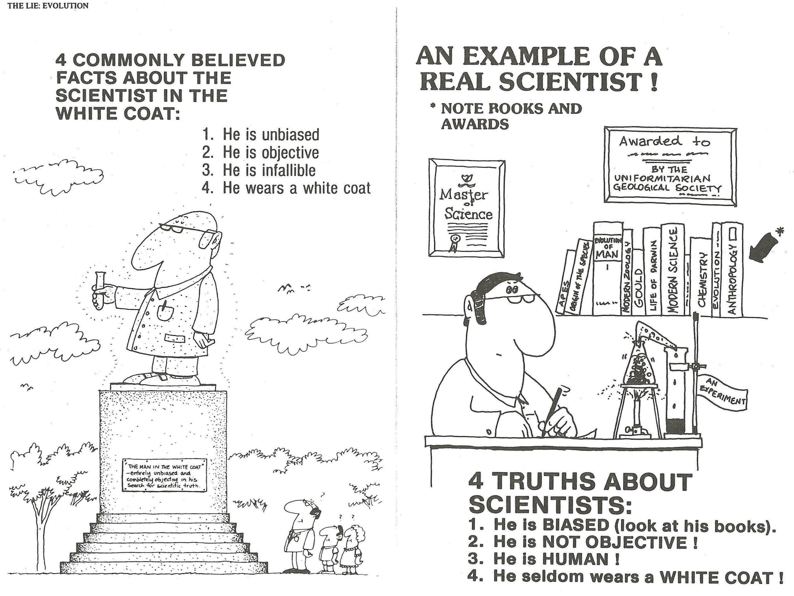
Unbiased?

Slide 4
Let’s Look at the Evidence for Noah’s Flood
1) Is there enough water ?
If we lower the mountain ranges…
If we raise the ocean bottoms…
If we melt the polar ice…
There is at least 1 Mile deep of coverage all over the earth!

Slide 5

Water depth of 1 Mile!
Lower Mountains
Raise Ocean Bottoms
Melt Polar Ice
Ps. 104:8 The mountains rose; the valleys sank down to the place which You established for them.

Slide 6
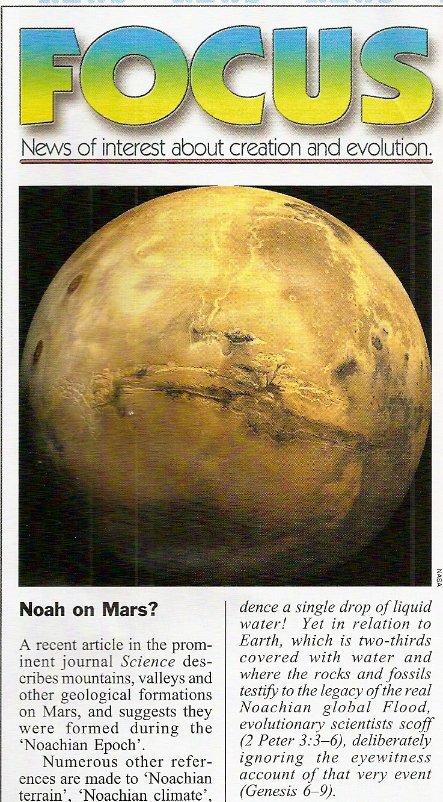
Mars Flood?
Scientists insisted that Mars must have had a Noachian Epoch!
Evidenced from the surface geology of valleys, mountains, etc…were formed by water...

Slide 7
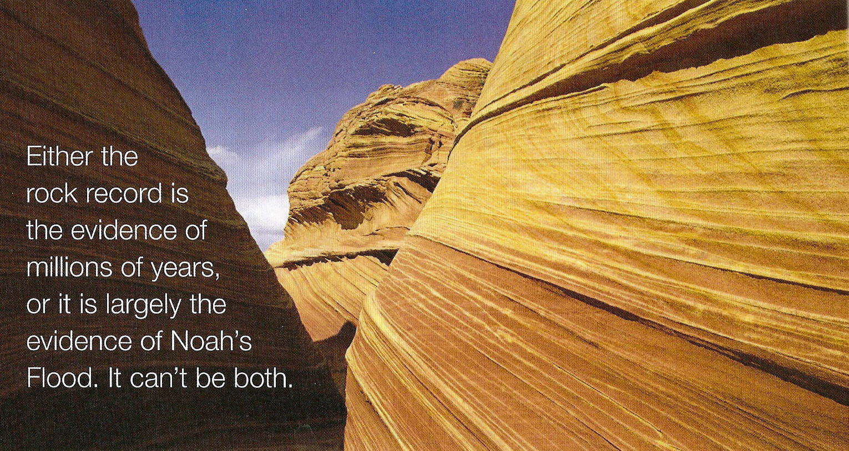
2) All of the land including the mountains has been under water!
75% of all land is Sedimentary Rock and all of the Geologic Column is water borne…
Erosion has exposed, washed away the other 25%
Gen. 7: 19 And the waters prevailed exceedingly on the earth, and all the high hills under the whole heaven were covered.
20 The waters prevailed fifteen cubits upward, and the mountains were covered.

Slide 8

75% of the land…Sedimentary Rock (Laid down by water)
But the Earth is already covered by water up to 75%!

Slide 9
3) Massive graveyards of fossils exist all over the earth. Millions of sea life creatures on top of the mountains!

Slide 10

Fossil Graveyards all Over the World
vv
v
v

Slide 11
4) What buried in mass plant life to create coal and what buried in mass animal life to create oil?
Coal is plant life buried & crushed, heated, and morphed…
Oil is animal life buried & crushed, heated, and morphed…

Slide 12
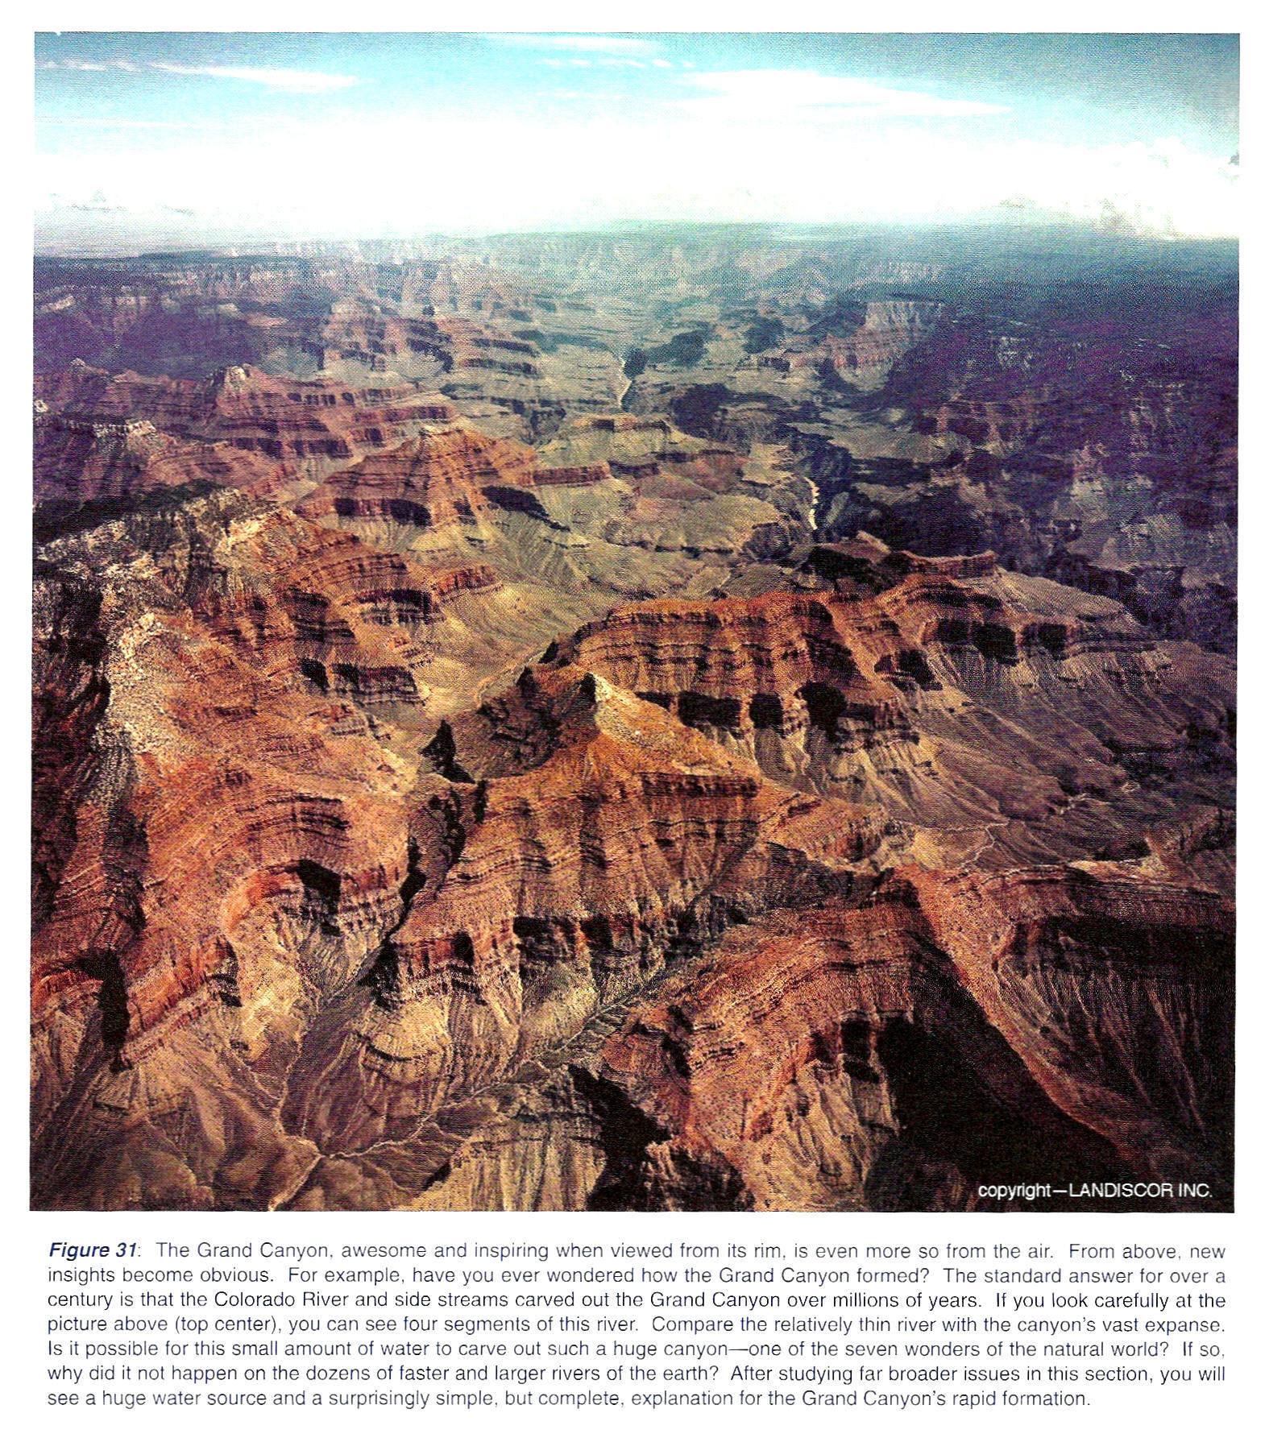
5) The geologic column is better understood to have been laid down by Noah’s Flood.

Slide 13
Covered Last Week:
1) No erosion between layers…
2) Poly Strata Fossils mean rapid deposition…
3) The man-made artifacts, foot prints, utensils, found in all layers…
4) The upper layers of the geologic column Where were they for millions of years?
5) Folded, Bent, and Buckled layers???

Slide 14
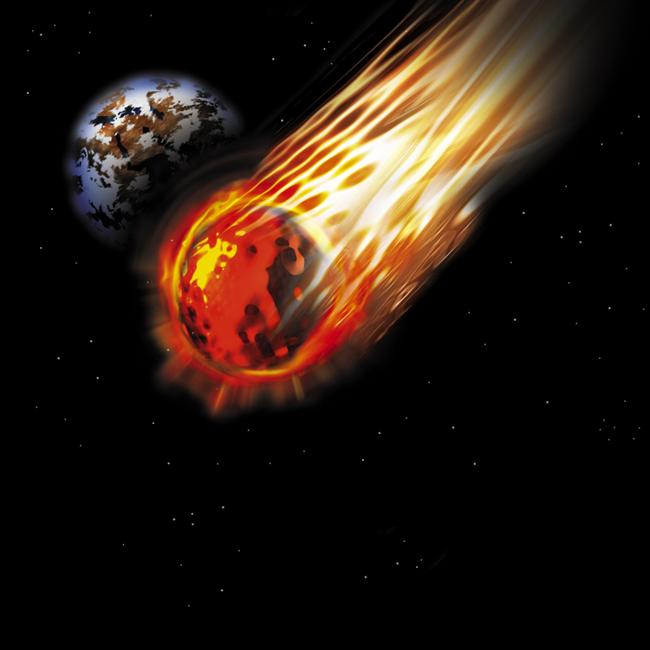
A New Piece of Evidence!
Meteorites are only found in the upper layers…no scars, or craters, have been found in the lower layers…this means no meteorites for millions of years?

Slide 15
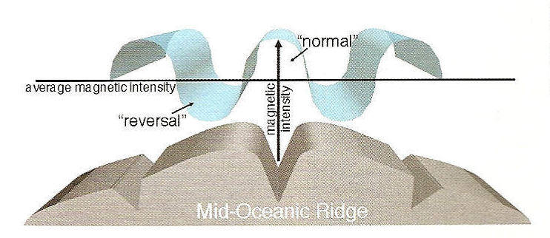
6) What formed to mountains?
There is no power on earth today to explain how the mountains and continents moved to form the mountain ranges…further, there is nothing to explain the ocean depths???
Ps. 104:8 The mountains rose; the valleys sank down to the place which You established for them.

Slide 16
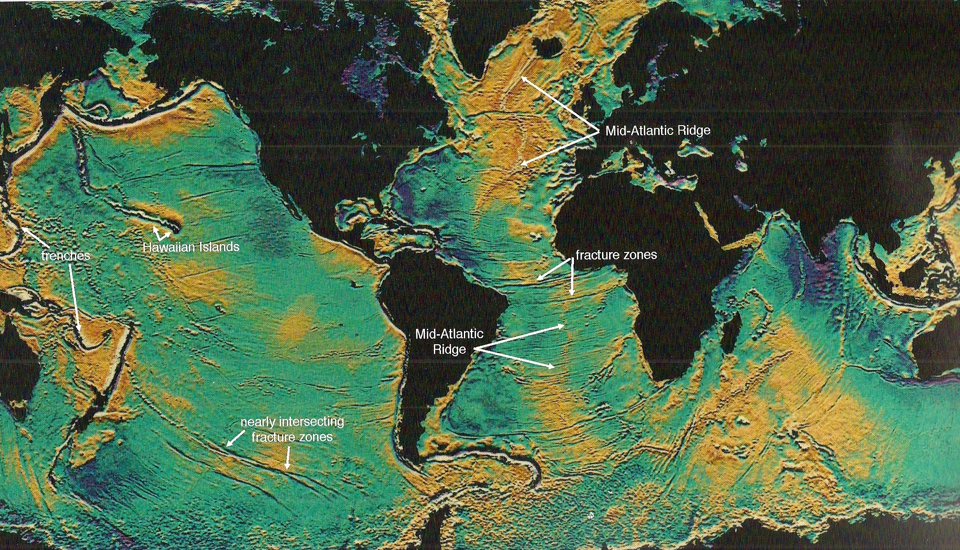
The great subterranean divides!

Slide 17


The World Before the Flood & After
II Pet. 3:6 by which the world that then existed perished, being flooded with water.

Slide 18
6) Fossils formed & buried in a relatively short period of time.

Slide 19
7) There are up to 500 FLOOD LEGENDS by cultures, countries, and tribes from ALL over the earth describing similar details as is found in the Bible!
Aborigines, Siberian, Babylonian, Chinese, Japanese, American Indian, Incas, Aztec, Egyptian, Mongolian, Arabian, Hittite, Polynesian, to name a few.

Slide 20
8) Cave Drawings & Dragon legends
The Word Dinosaur is only
recent in modern
history…
Job 40:15 "Look now at the behemoth, which I made along with you; He eats grass like an ox.
16 See now, his strength is in his hips, And his power is in his stomach muscles.
17 He moves his tail like a cedar; The sinews of his thighs are tightly knit.
18 His bones are like beams of bronze, His ribs like bars of iron.

Slide 21
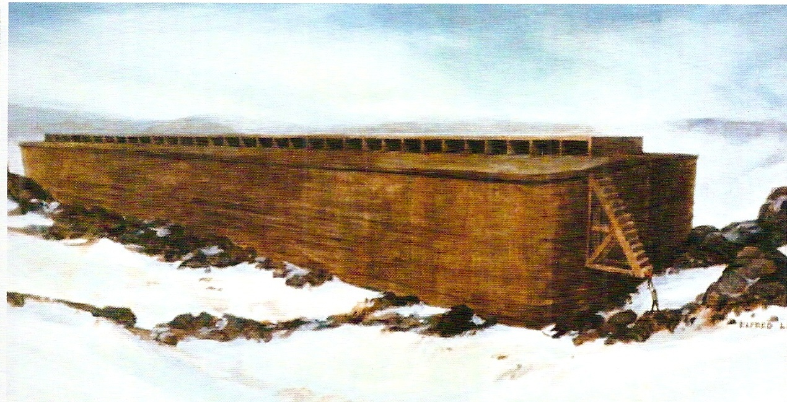
8) The Ark was more than big enough!

Slide 22
Was Noah’s Ark Big Enough?

Slide 23
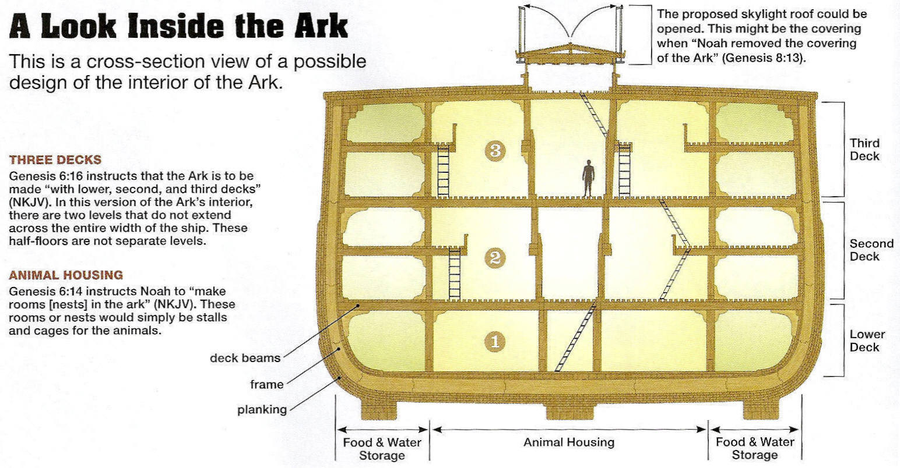
522 Railroad Cars Big!

Slide 24
The most important evidence for a worldwide flood.
Gen. 6: 1 The earth also was corrupt before God, and the earth was filled with violence.
12 So God looked upon the earth, and indeed it was corrupt; for all flesh had corrupted their way on the earth.
13 And God said to Noah, "The end of all flesh has come before Me, for the earth is filled with violence through them; and behold, I will destroy them with the earth.
14 “Make yourself an ark of gopher wood; make rooms in the ark, and cover it inside and outside with pitch.
17 "And behold, I Myself am bringing floodwaters on the earth, to destroy from under heaven all flesh in which is the breath of life; everything that is on the earth shall die.
18 “But I will establish My covenant with you; and you shall go into the ark––you, your sons, your wife, and your sons’ wives with you.
19 “And of every living thing of all flesh you shall bring two of every sort into the ark, to keep them alive with you; they shall be male and female.

Slide 25
7:1 Then the LORD said to Noah, "Come into the ark, you and all your household, because I have seen that you are righteous before Me in this generation.
2 “You shall take with you seven each of every clean animal, a male and his female; two each of animals that are unclean, a male and his female;
3 “also seven each of birds of the air, male and female, to keep the species alive on the face of all the earth.
4 "For after seven more days I will cause it to rain on the earth forty days and forty nights, and I will destroy from the face of the earth all living things that I have made."
11 In the six hundredth year of Noah’s life, in the second month, the seventeenth day of the month, on that day all the fountains of the great deep were broken up, and the windows of heaven were opened.
12 And the rain was on the earth forty days and forty nights.
13 On the very same day Noah and Noah’s sons, Shem, Ham, and Japheth, and Noah’s wife and the three wives of his sons with them, entered the ark––

Slide 26
17 Now the flood was on the earth forty days. The waters increased and lifted up the ark, and it rose high above the earth.
18 The waters prevailed and greatly increased on the earth, and the ark moved about on the surface of the waters.
19 And the waters prevailed exceedingly on the earth, and all the high hills under the whole heaven were covered.
20 The waters prevailed fifteen cubits upward, and the mountains were covered.
21 And all flesh died that moved on the earth: birds and cattle and beasts and every creeping thing that creeps on the earth, and every man.
22 All in whose nostrils was the breath of the spirit of life, all that was on the dry land, died.
8: 4 And the waters prevailed on the earth one hundred and fifty days.
1 Then God remembered Noah, and every living thing, and all the animals that were with him in the ark. And God made a wind to pass over the earth, and the waters subsided.
2 The fountains of the deep and the windows of heaven were also stopped, and the rain from heaven was restrained.
3 And the waters receded continually from the earth. At the end of the hundred and fifty days the waters decreased.
4 Then the ark rested in the seventh month, the seventeenth day of the month, on the mountains of Ararat.
5 And the waters decreased continually until the tenth month. In the tenth month, on the first day of the month, the tops of the mountains were seen.

Slide 27
5 Then God spoke to Noah, saying,
16 “Go out of the ark, you and your wife, and your sons and your sons’ wives with you.
17 “Bring out with you every living thing of all flesh that is with you: birds and cattle and every creeping thing that creeps on the earth, so that they may abound on the earth, and be fruitful and multiply on the earth."
18 So Noah went out, and his sons and his wife and his sons’ wives with him.
19 Every animal, every creeping thing, every bird, and whatever creeps on the earth, according to their families, went out of the ark.
13 And it came to pass in the six hundred and first year, in the first month, the first day of the month, that the waters were dried up from the earth; and Noah removed the covering of the ark and looked, and indeed the surface of the ground was dry.
14 And in the second month, on the twenty–seventh day of the month, the earth was dried.

Slide 28
20 Then Noah built an altar to the LORD, and took of every clean animal and of every clean bird, and offered burnt offerings on the altar.
21 And the LORD smelled a soothing aroma. Then the LORD said in His heart, "I will never again curse the ground for man’s sake, although the imagination of man’s heart is evil from his youth; nor will I again destroy every living thing as I have done.
22 “While the earth remains, Seedtime and harvest, Cold and heat, Winter and summer, And day and night Shall not cease."
How Long Did Noah stay in the ark?
Did you know it had never rained before the flood?
The Seasons of summer and winter, cold and heat, did not exist before the flood…
Do You Remember what sign God gave that He’d never destroy the earth by water again?

Slide 29

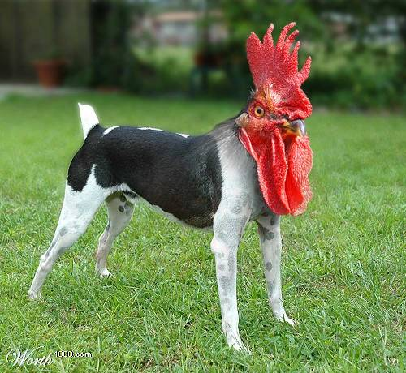
Some Creatures that Defy Creation?

Slide 30

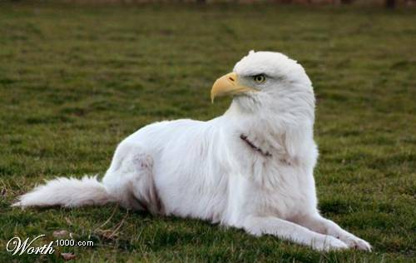
Some More…

