Slide 1
Did You Know How Little Creation is Taught?
Creation and the Bible
Keeping you updated…

Slide 2
Don’t be deceived this debate is over truth and foundations.
Ps 11:3 If the foundations are destroyed, What can the righteous do?
1Ti 4:1 Now the Spirit expressly says that in latter times some will depart from the faith, giving heed to deceiving spirits and doctrines of demons,

Slide 3
There is No True Reconciliation Between the Bible and Evolution…

Slide 4
Jesus said:
Mark 10: 6 “But from the beginning of the creation, God ‘made them male and female.’
7 ‘For this reason a man shall leave his father and mother and be joined to his wife,
8 ‘and the two shall become one flesh’; so then they are no longer two, but one flesh.
And,
John 5:46 “For if you believed Moses, you would believe Me; for he wrote about Me.

Slide 5
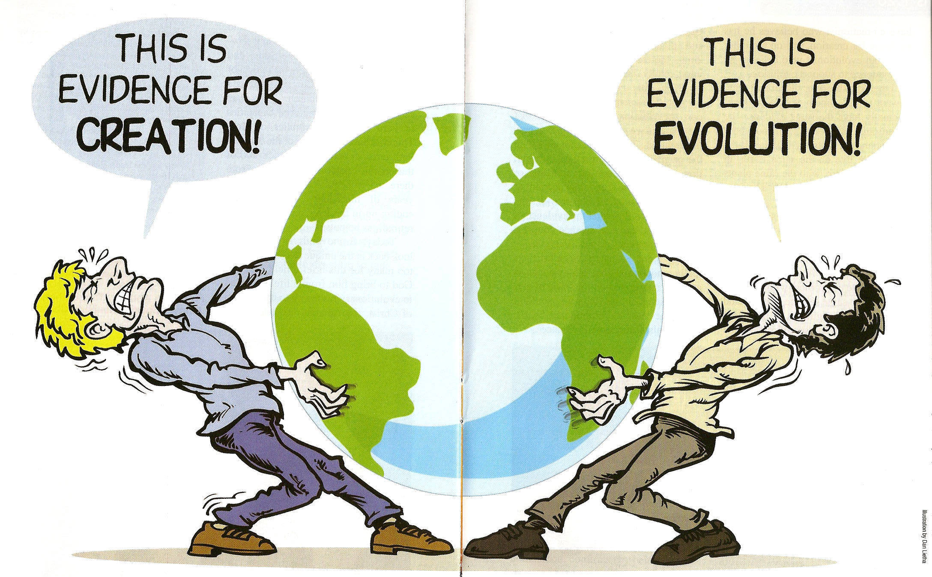
Richard Dawkins wrote, “That anyone who denies evolution is either ignorant, stupid or insane.”

Slide 6
Faith vs. Science?
There is no evidence anywhere that substantiates evolution where we can see it; but we are told adamantly that it occurred where we can’t see it.
“What we have then is the word “evolution” that is used as a wand to wave over mysteries, a miracle otherwise being discounted for the lack of any explanation.” (Michael Behe, DBB)
When the facts are not forth coming, the propaganda is.

Slide 7
Let me share some ignorant, stupid, and insane things that validate creation.
1) Where Did the Non Material World Come From?
Evolution has no explanation for the origin of intelligence, information, and the non physical world…
Ps 19:1The heavens declare the glory of God; And the firmament shows His handiwork.
Ro 1:20 For since the creation of the world His invisible attributes are clearly seen, being understood by the things that are made, even His eternal power and Godhead, so that they are without excuse,

Slide 8
2) The Bible’s Timeline is Contradicted by Evolution
Genealogies make it impossible…
  Real records
  About Real People
  Establishing real time frames
  Connecting the beginning to Christ…

Slide 9

3) Death, Decay and Devouring Started When?

Slide 10
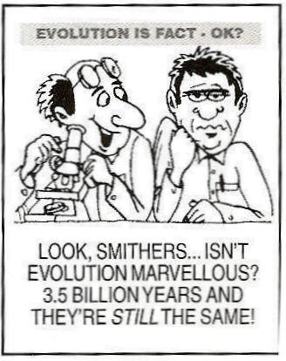
4) The Law of Genesis: Everything Reproduces After Its Kinds is Contradicted by Evolution

Slide 11
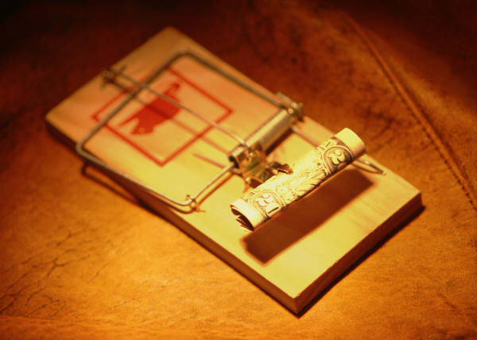
5) Irreducible Complexity Stops Evolution Completely
The Mouse Trap

Slide 12

The Cretaceous Period was about 136 million to 65 million years ago.
6) Human Foot Prints with Dinosaurs Foot Prints? This Totally Destroys Evolution’s Time Frame

Slide 13
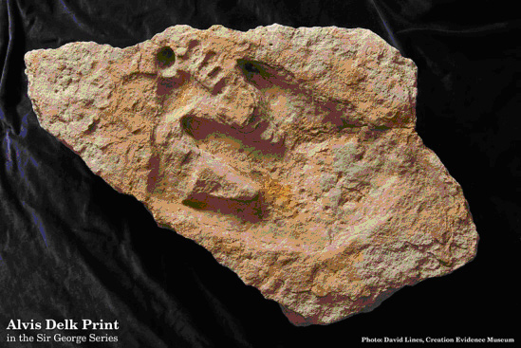
The Cretaceous Period was about 136 million to 65 million years ago.
The Creation Evidence Museum is in possession of a set of Cretaceous footprints discovered by amateur archaeologist Alvis Delk[1] of Stephenville, Texas. This fossil of dense Glen Rose limestone consists of Dinosaur footprint (Acrocanthosaurus) and an eleven-inch human footprint intruded by the dinosaur print.

Slide 14
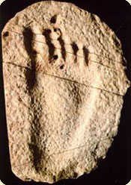
The Burdick Track, discovered in Cretaceous rock along the Cross Branch near Glen Rose, Texas. This human footprint in rock was purchased by the late Dr. Clifford Burdick and ultimately became the possession of the Creation Evidence Museum. All the toes and arches of the human anatomy are clearly discernible.

Slide 15
7) The Sedimentary Layers Expand All Over the Globe! This Points to A Worldwide Flood Not Long Ages
No Erosion between layers
Rapid Burial of Massive Fossil Graveyards all over the earth including on top of mountains—all laid down by water
Poly Strata Fossils
Man Made Artifacts found in all layers?
Folded and Bent Layers?
Where were all the layers?

Slide 16
This is a tree trunk buried and fossilized in multiple layers of the geologic column.
1 M

Slide 17
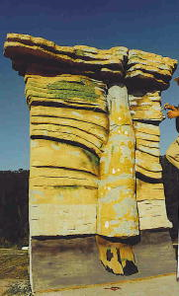
No erosion between layers
Poly strata fossil across millions of years?

Slide 18
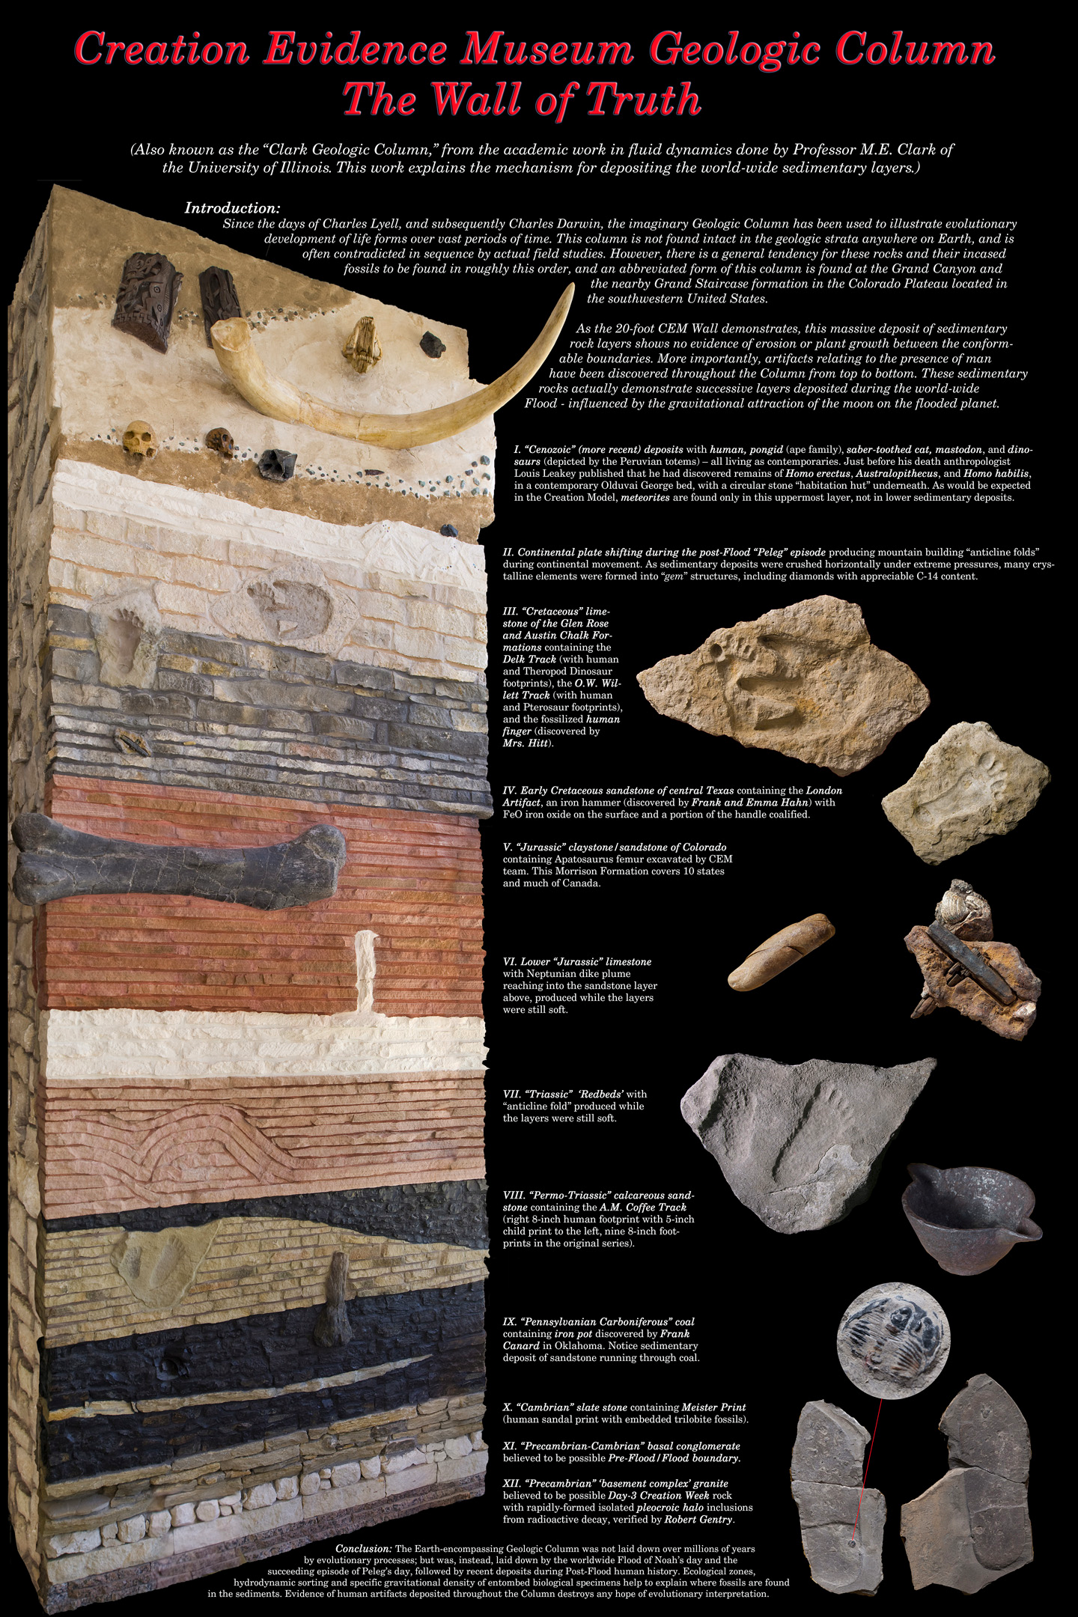

Slide 19
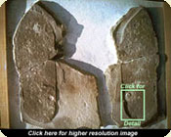
The Cambrian Period was from about 543 to 490 million years ago.
The Meister Print, discovered in Cambrian slate in 1968 by the late William Meister near Antelope Springs, Utah. The artifact includes a positive and negative impression of a human sandal print with some of the stitching showing along the edges. In the heel and toe areas two trilobites are crushed.

Slide 20
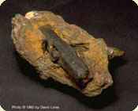
The London Artifact, discover in June, 1934 by Frank and Emma Hahn near London, Texas. This artifact is a metal hammer in Cretaceous rock. The hammer is composed of 96.6% iron, 0.74% sulfur, and 2.6% chlorine. This chlorine composition in compound with metallic iron renders this artifact unreproducable by modern scientific methods.

Slide 21

Replica of the Stegosaurus carved in a ten-foot column at the Ta Prohm Cambodian Temple dedicated in 1186.

Slide 22
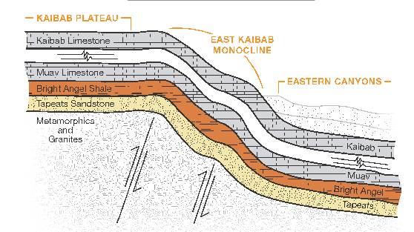

Slide 23
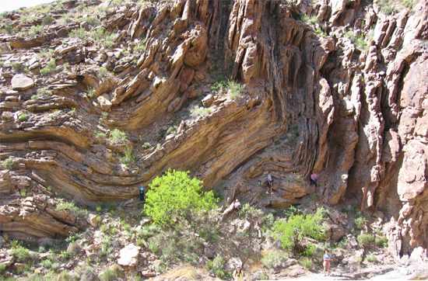

Slide 24
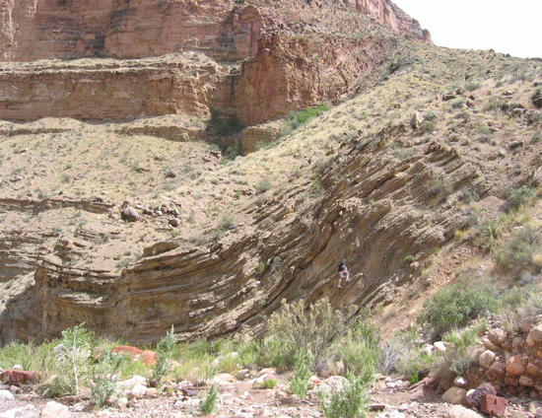

Slide 25
All the layers WERE together then they folded? How is that possible over long ages?

Slide 26
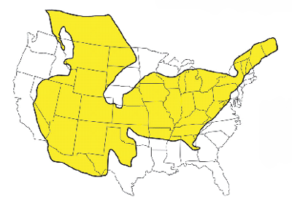
Folded and Bent Layers of Rock!
Figure 2: This phenomenon was not regional. The Tapeats Sandstone spans the continent, and other layers span much of the globe.

Slide 27
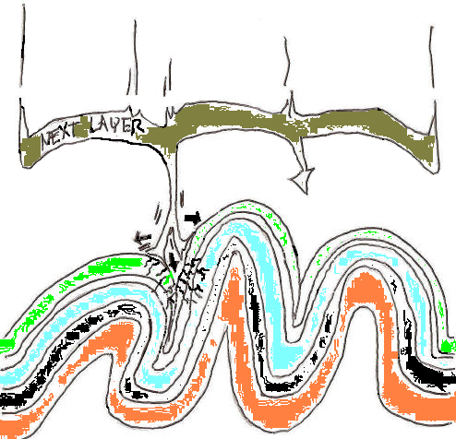
Where were the layers before they accumulated? Where is the next one?
How will it fold?
Layers in thin air?

Slide 28
Granite’s Creation Secret
Polonium 214 with a half life of 0.00164 seconds.
These tiny little halos Captured in Granite Scream instantaneous Creation!
Ge 1:9 Then God said, "Let the waters under the heavens be gathered together into one place, and let the dry land appear"; and it was so.

